Slide 1




COLLEGE WEB
Presented by:
Laxit Shah-202212042
Arkan Mansuri-202212055

Slide 2




What is College Web?
A Web Based Platform.
Transforming Student And College Interaction
Helps students make informed college choices

Slide 3


Why is College Web?
Colleges require websites for improved communication, but not all can develop them.
Website Creation becomes easy within a few click.
Centralized platform to display all colleges.
Exploring Colleges by Courses Offered.

Slide 4






TOOLS AND TECHNOLOGY USED
MongoDB
Express JS
React JS
Node JS

Slide 5




Stakeholders
Visitor
Student
College Admin

Slide 6

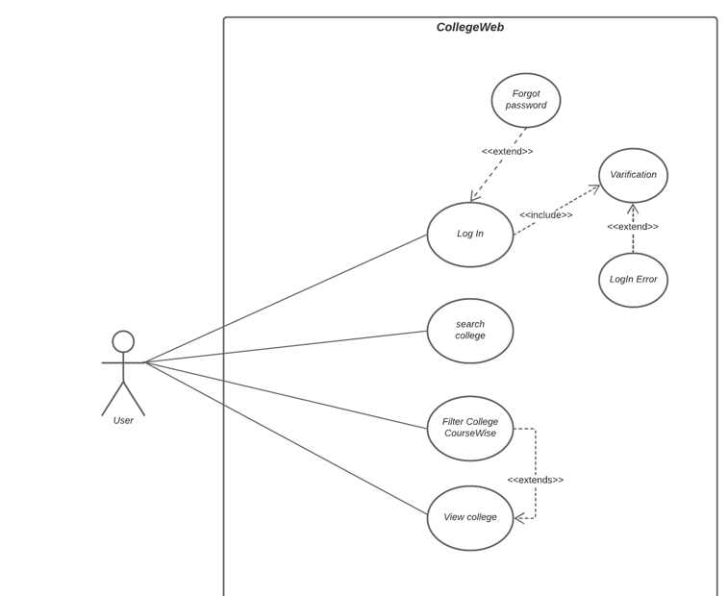

Visitor's Perspective

Slide 7

Visitor's
Functionalities
User Registration and Login
Mail Authentication
View and Search College
Filter College

Slide 8
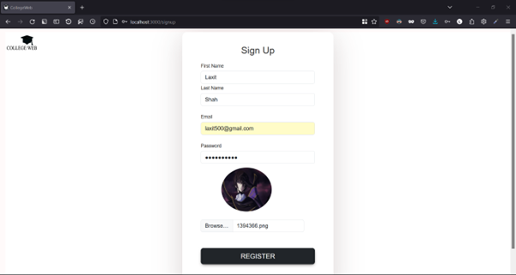
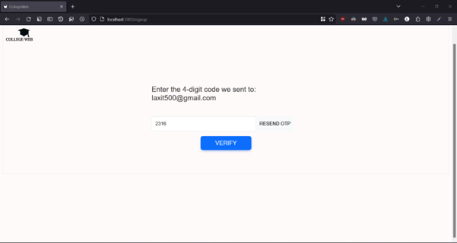
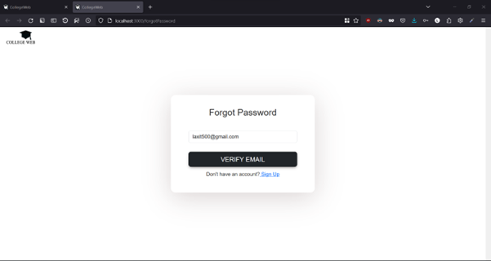
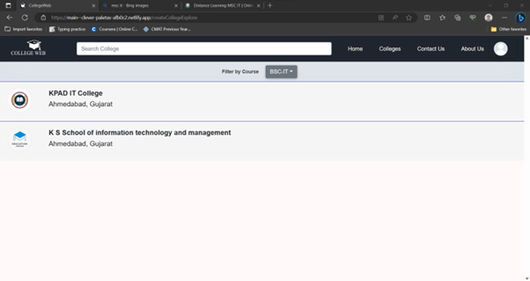

Slide 9
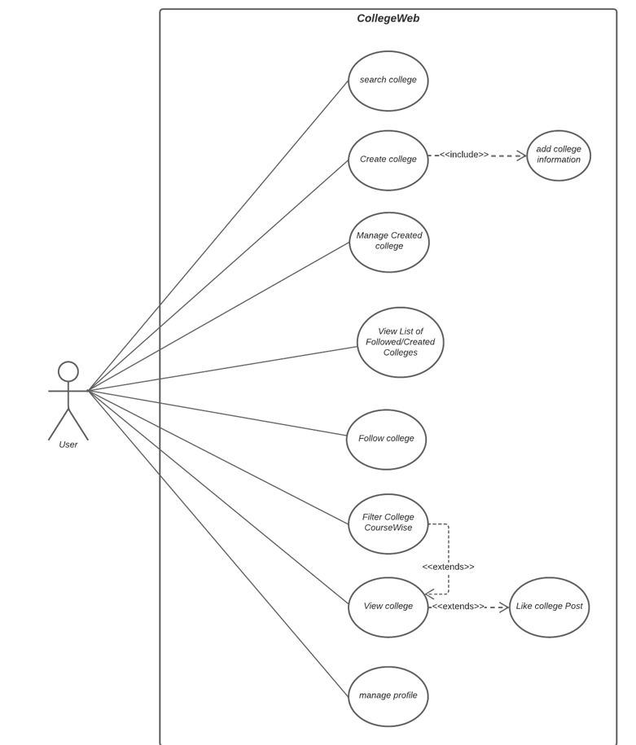


Student’s Perspective

Slide 10

Student’s
Functionalities
Student Profiles
View Detailed College Profiles
Course-Based College Search
Like and Follow Colleges
Search Filters and Sorting Options
Real-time Updates and Notices
Interactive Campus Guide

Slide 11
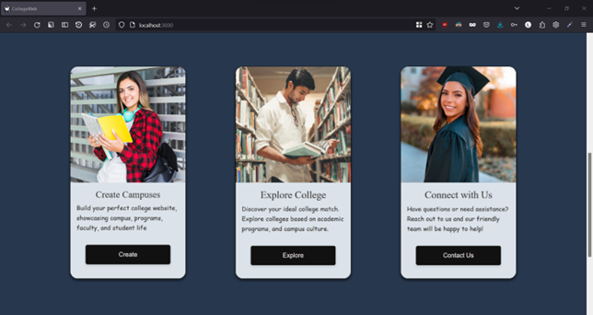
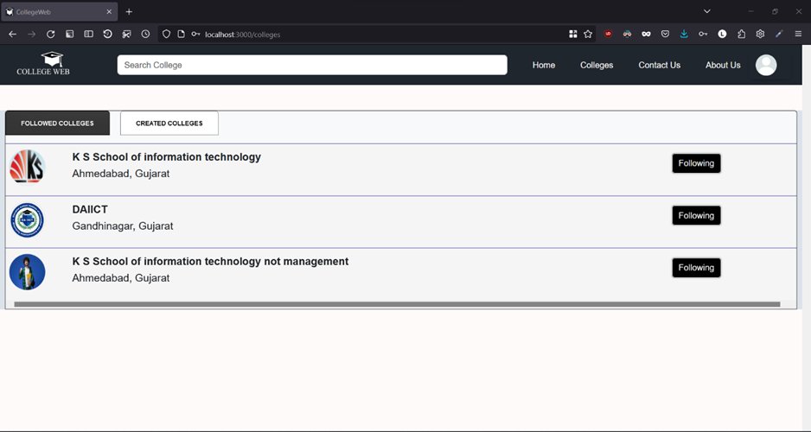
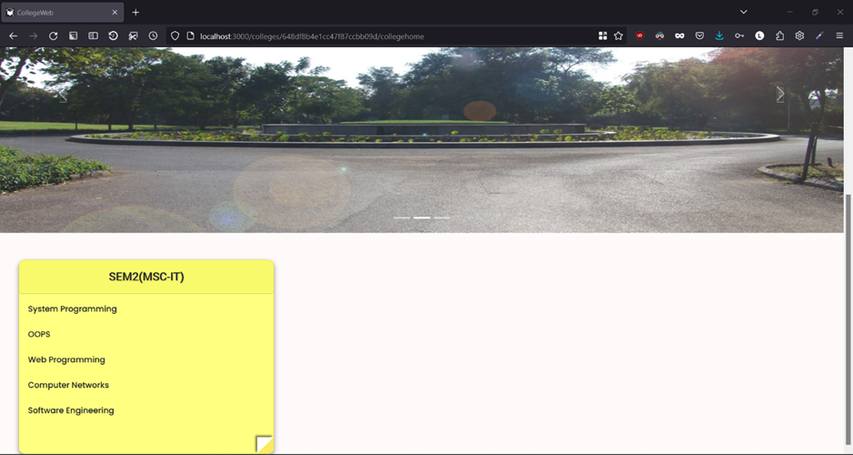
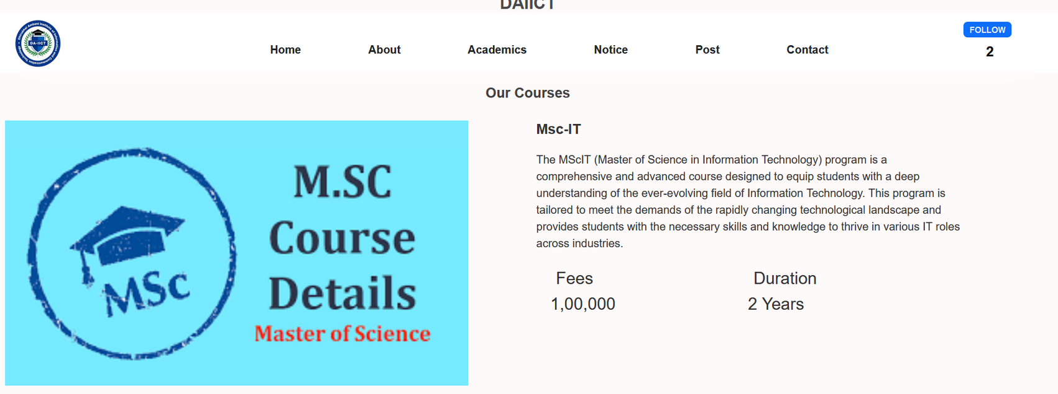

Slide 12
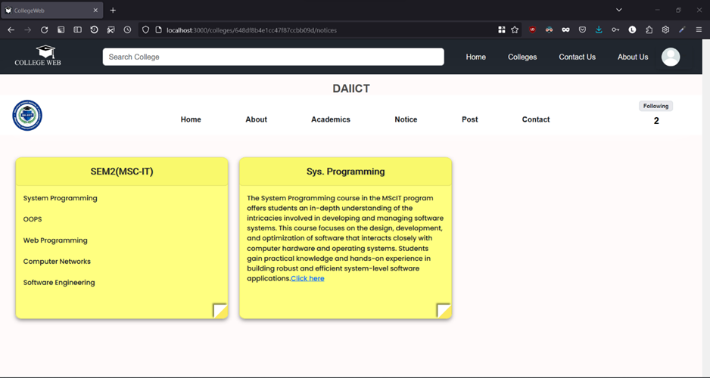
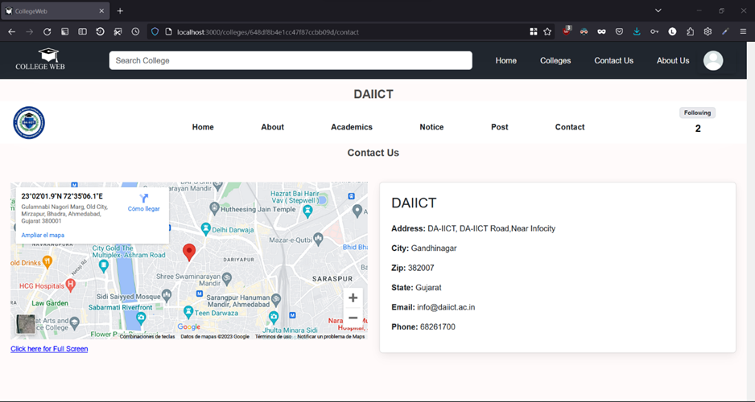
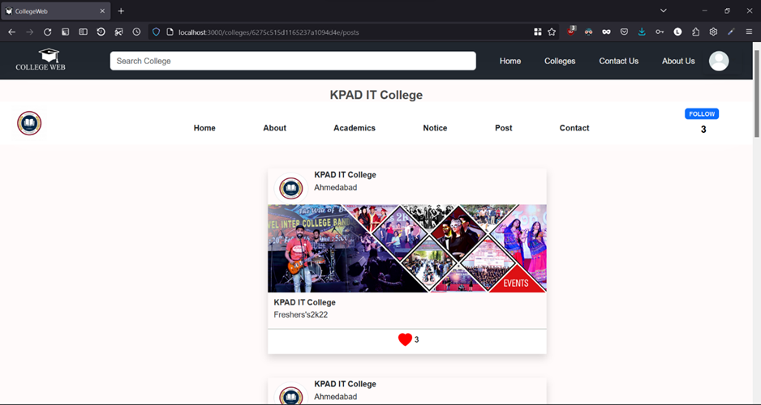
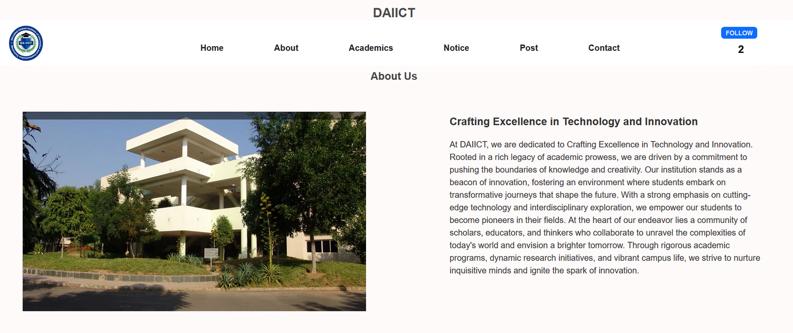

Slide 13
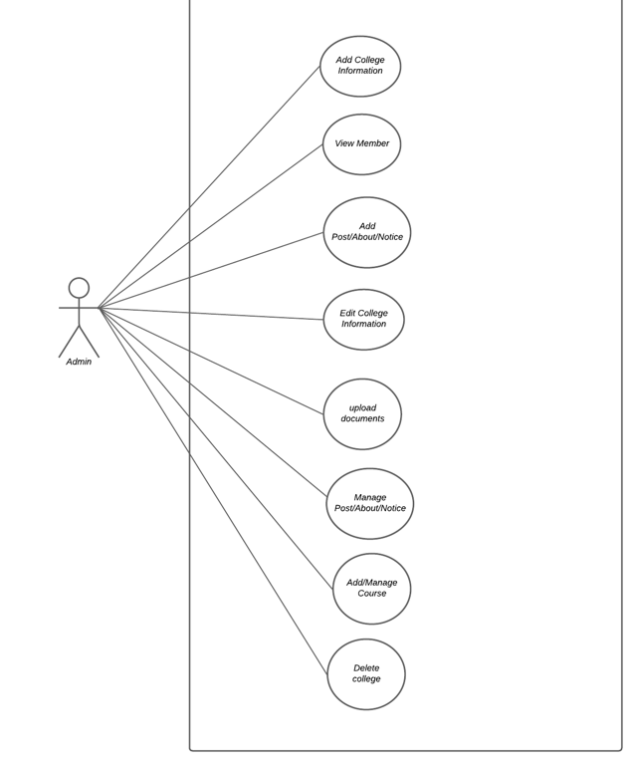

College Admin Perspective

Slide 14




COLLEGE ADMIN FUNCTIONALITIES
CREATE COLLEGE
COLLEGE PROFILE MANAGEMENT
ADD COLLEGE IMAGES
COURSE MANAGEMENT
CREATE,EDIT,DELETE POST
CREATE,EDIT ,DELETE NOTICES
PIN NOTICES
NOTIFICATION AND ANNOUNCEMENTS
ADD LOCATION USING MAPS
ADD CONTACT INFO

Slide 15
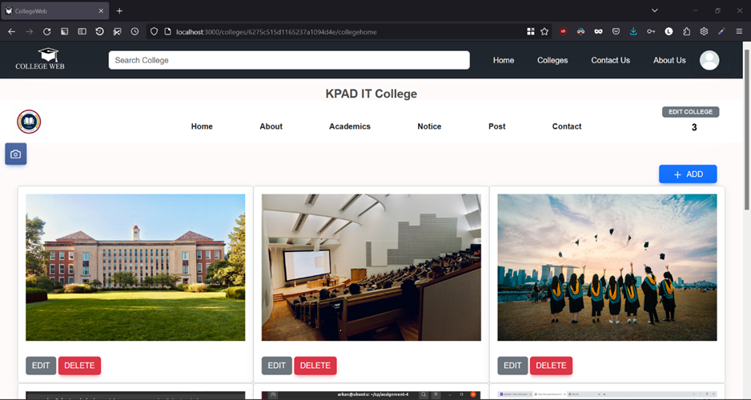
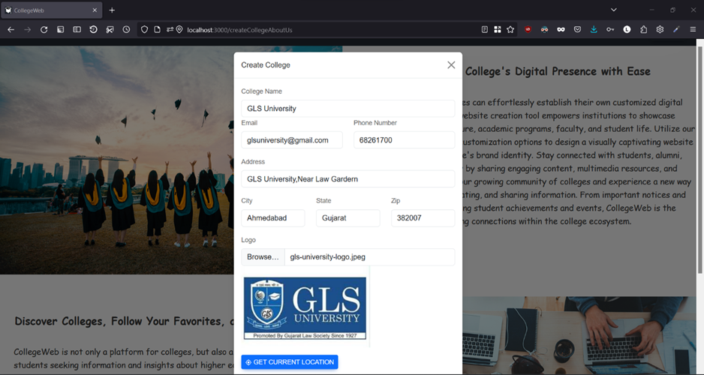
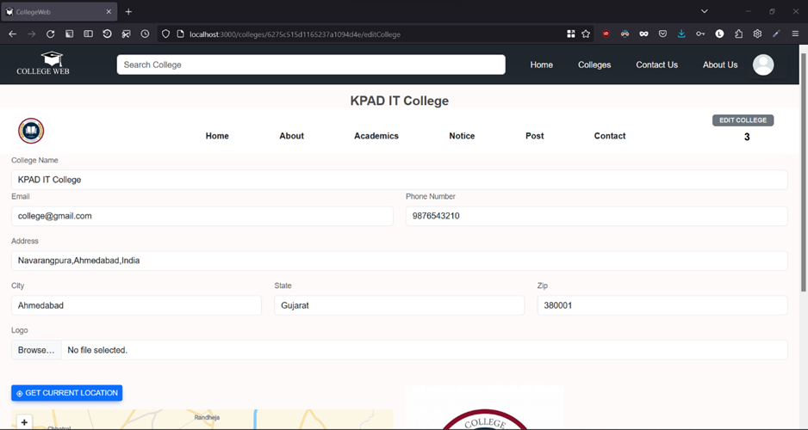
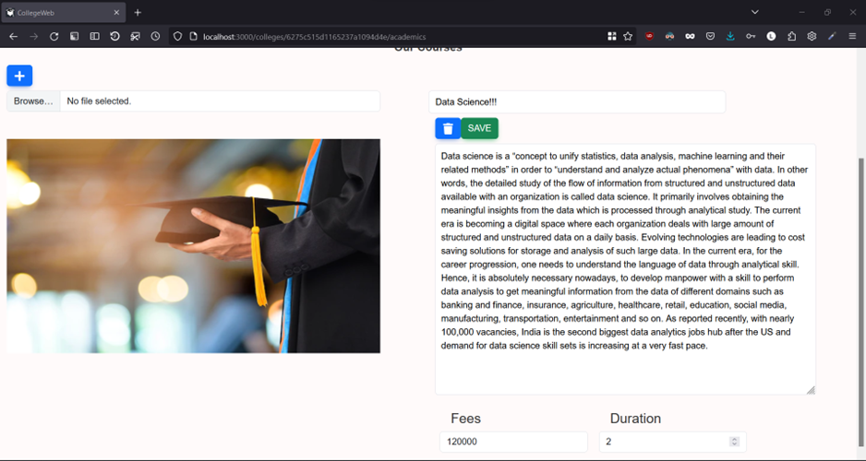

Slide 16
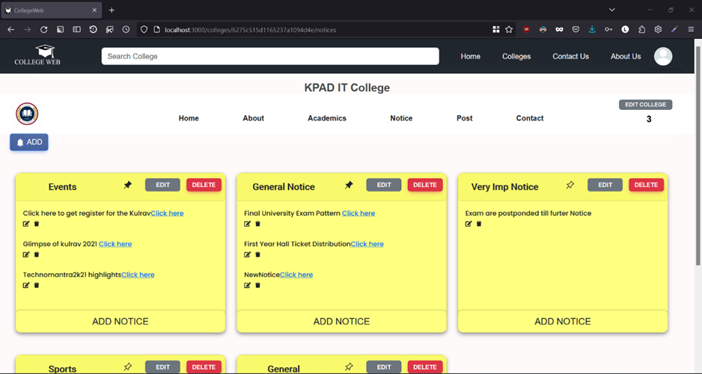
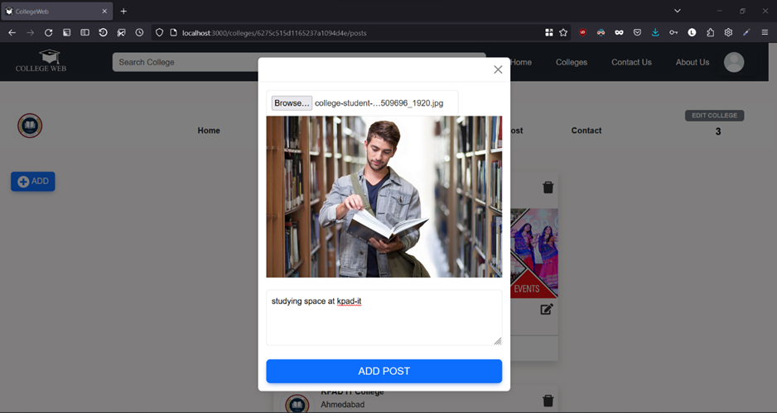
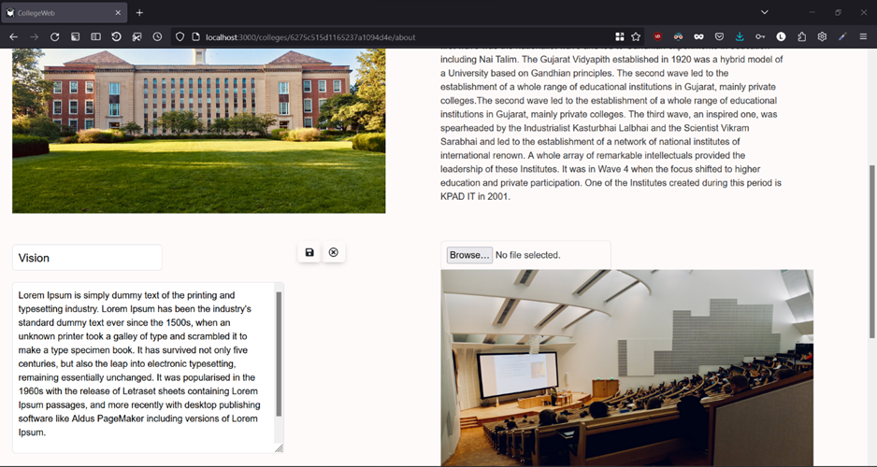
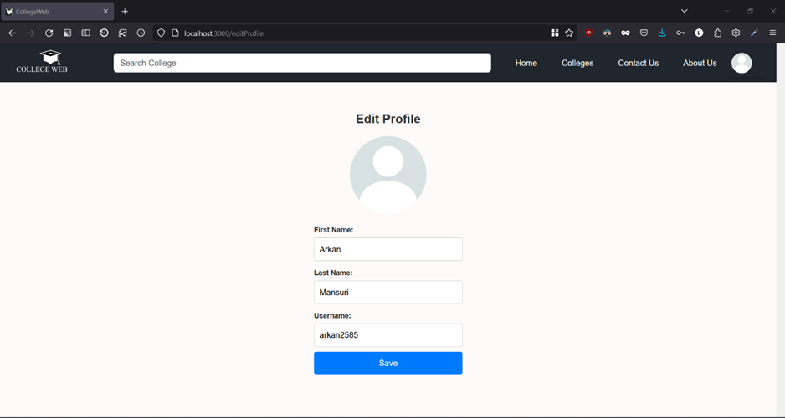

Slide 17





Engineer’s Perspective

Slide 18

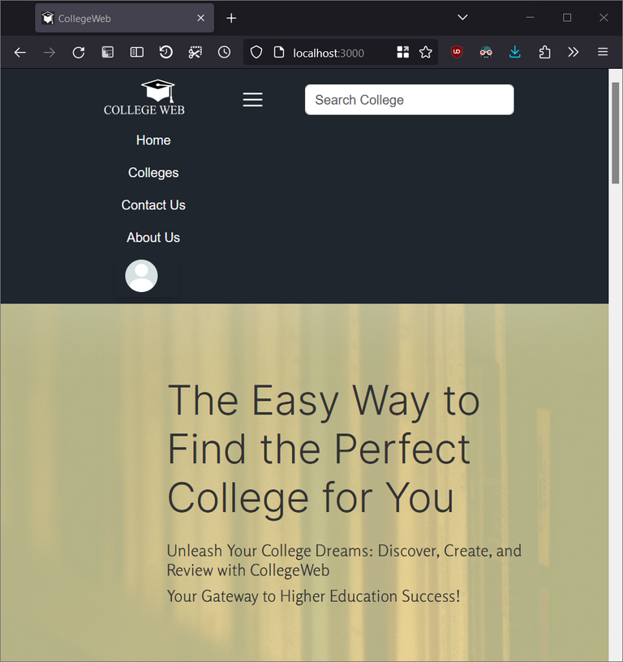
Design
Responsive UI

Slide 19

1.
3.
Integration of Third-Party APIs
User-Centric Design
Emphasizing responsive website design for diverse screen sizes to ensure accessibility and an optimal user experience on all devices
Demonstrated proficiency in integrating and leveraging the functionalities of diverse third-party APIs, such as Cloudinary, Netlify, OpenStreetMap, Passport, and Render, augmenting the platform's capabilities
2.
4.
Expertise in Frontend
Development
Effective Team Collaboration
Profound understanding and adeptness in utilizing front-end frameworks like Bootstrap and ReactStrap, harnessing their components and grid systems to streamline development and elevate visual aesthetics.
Cultivated a cohesive teamwork culture, fostering effective communication and collaboration to comprehend user requirements and deliver a project of exemplary quality within specified timelines.
Learnings

Slide 20


References
https://react.dev/learn
https://www.mongodb.com/docs/
https://www.w3schools.com/nodejs/
https://expressjs.com/
https://reactstrap.github.io/
@reallygreatsite

Slide 21


THANK YOU
Feel free to ask us any question
Go to our Github Repo:
https://github.com/202212055Arkan/CollegeWeb

